Slide 1

FASTENERS TRAINING
THEME: FASTENERS: VISUAL AIDS
Ibadan … Sub Sahara’s Best Competitive Solution

Slide 2
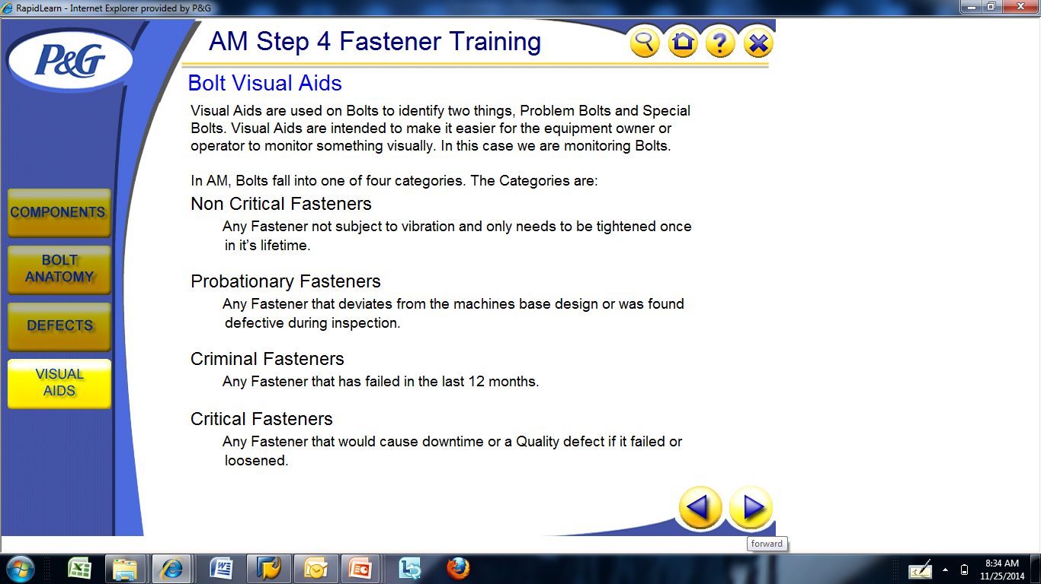
FASTENERS :- VISUAL AIDS
Bolt Visual aids:

Slide 3
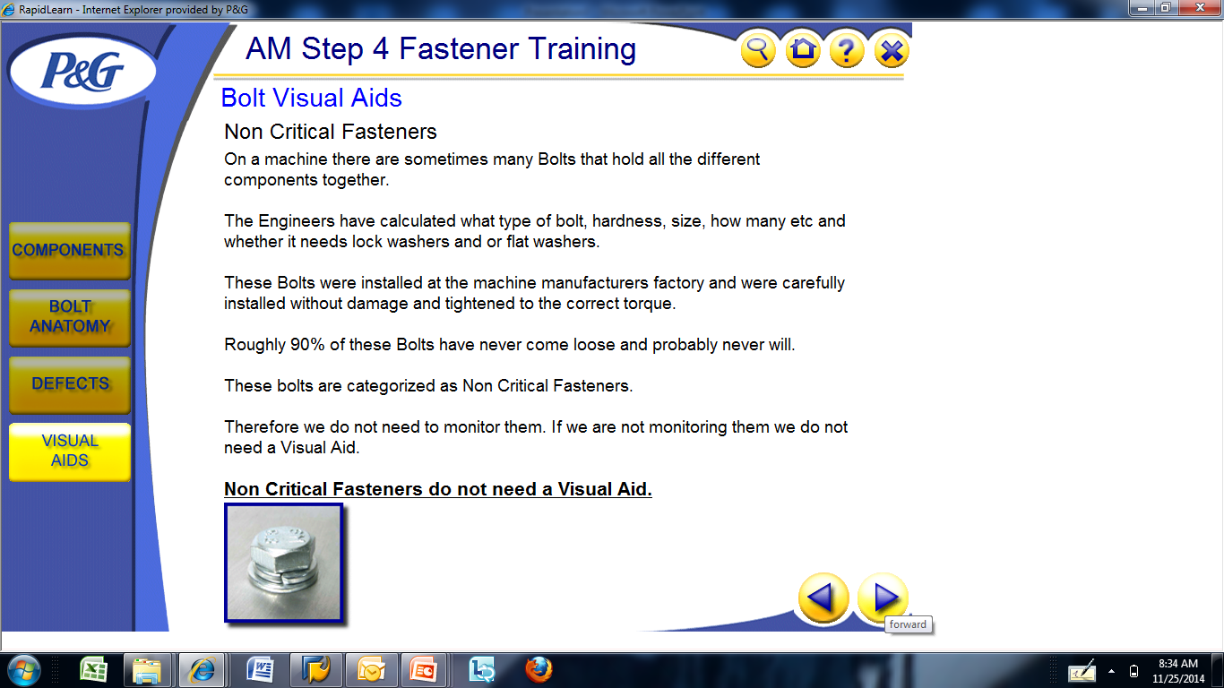
FASTENERS :- VISUAL AIDS
Bolt Visual aids :

Slide 4
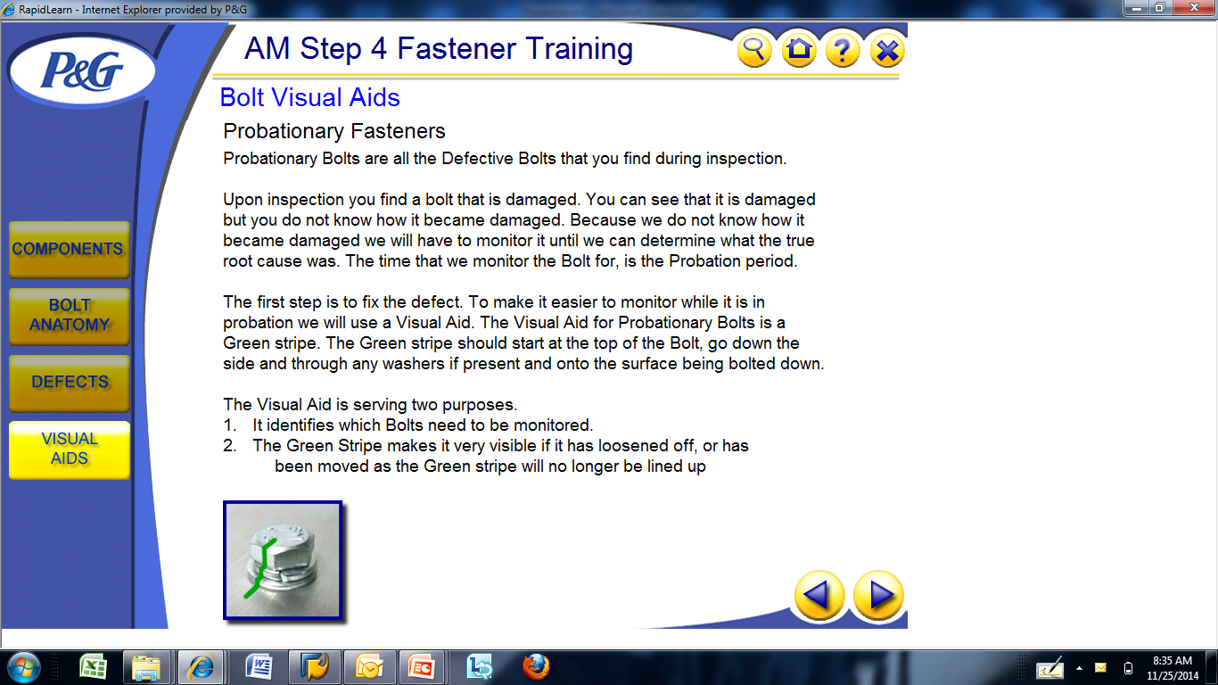
FASTENERS :- VISUAL AIDS
Bolt Visual aids:

Slide 5
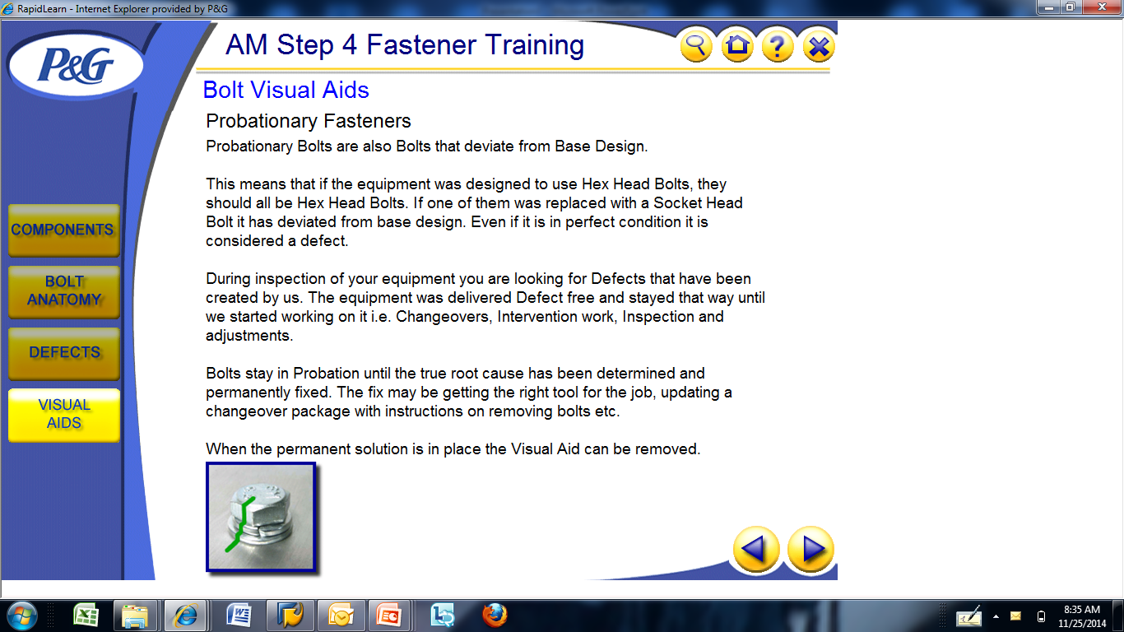
FASTENERS :- VISUAL AIDS
Bolt Visual aids :

Slide 6
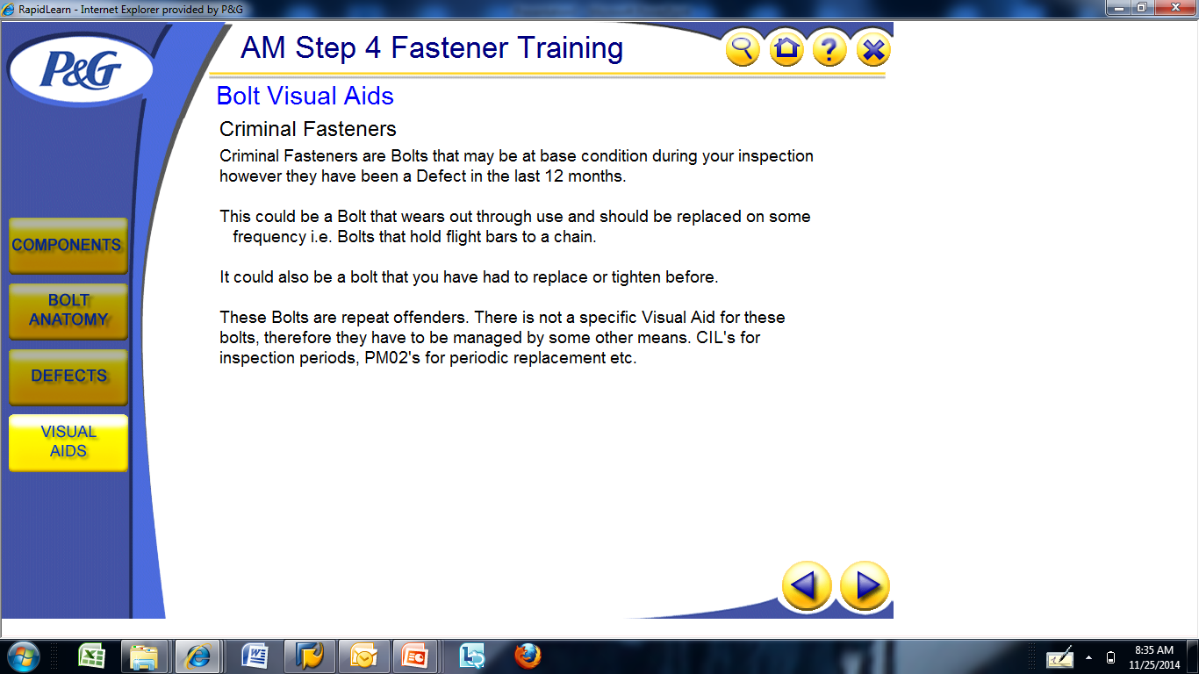
FASTENERS :- VISUAL AIDS
Bolt Visual aids :

Slide 7
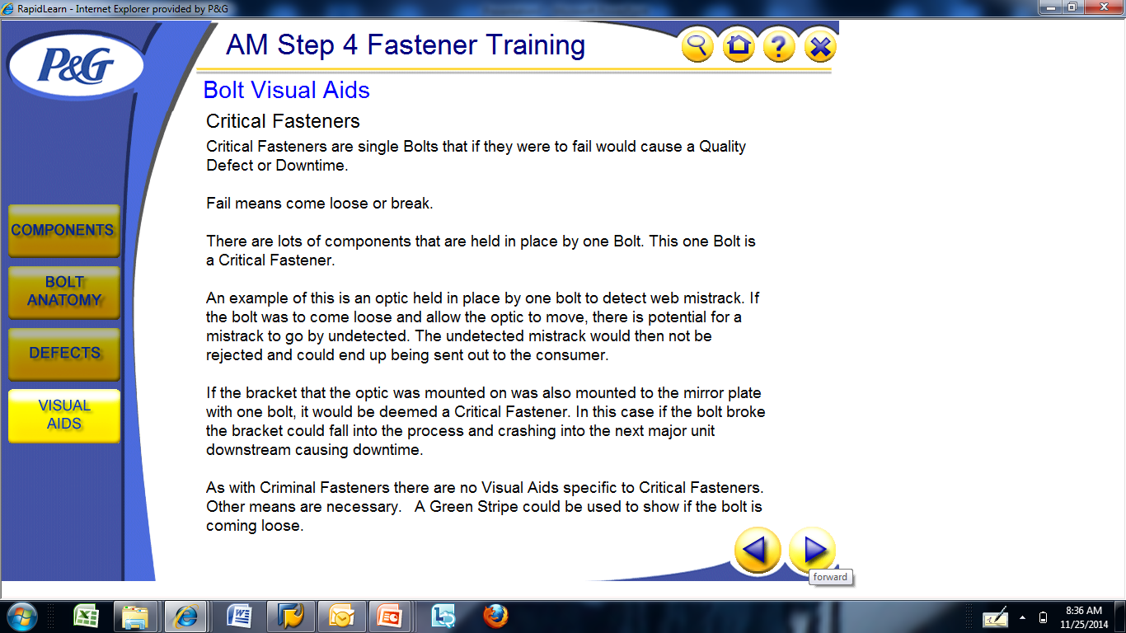
FASTENERS :- VISUAL AIDS
Bolt Visual aids :

Slide 8
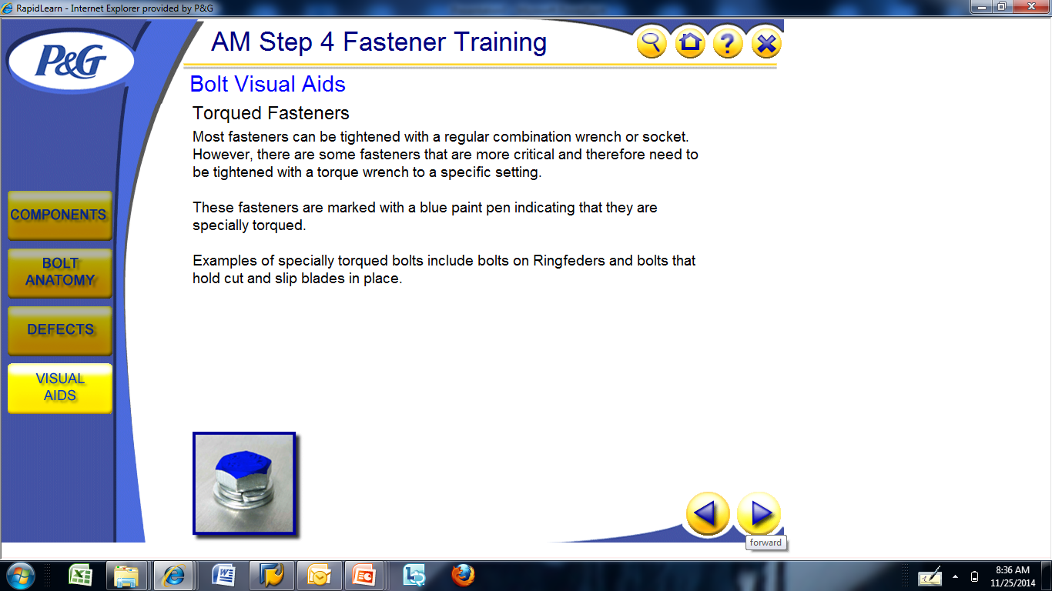
FASTENERS :- VISUAL AIDS
Bolt Visual aids:

Slide 9
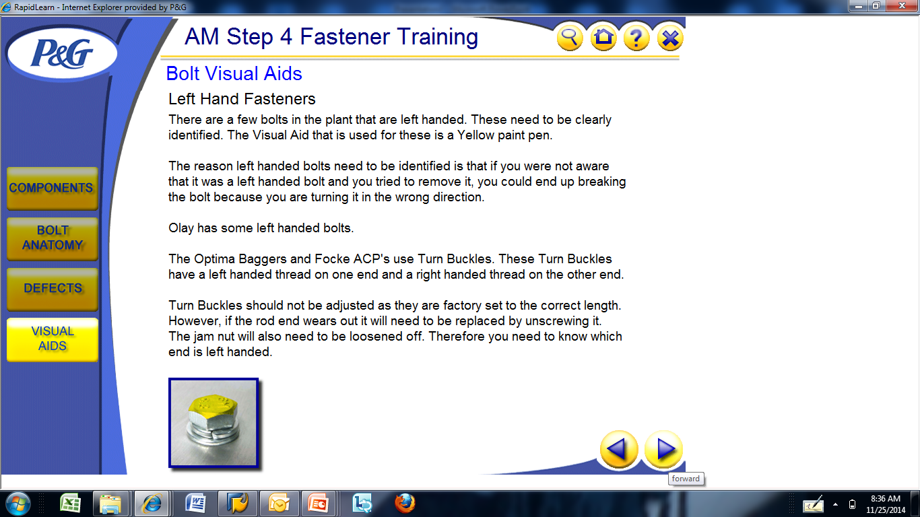
FASTENERS : VISUAL AIDS
Bolt Visual aids :

Slide 10
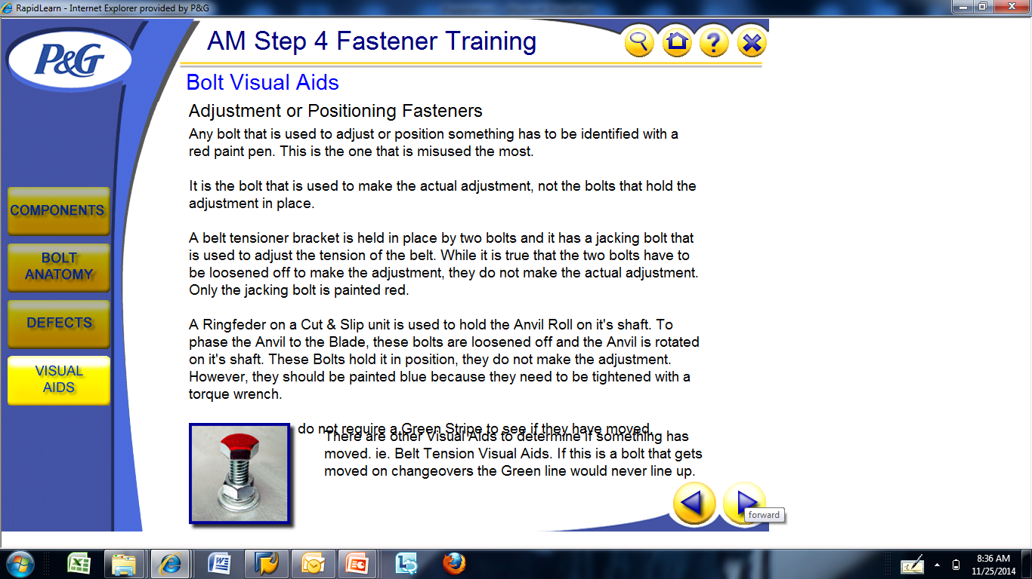
FASTENERS : VISUAL AIDS
Bolt Visual aids :

Slide 11
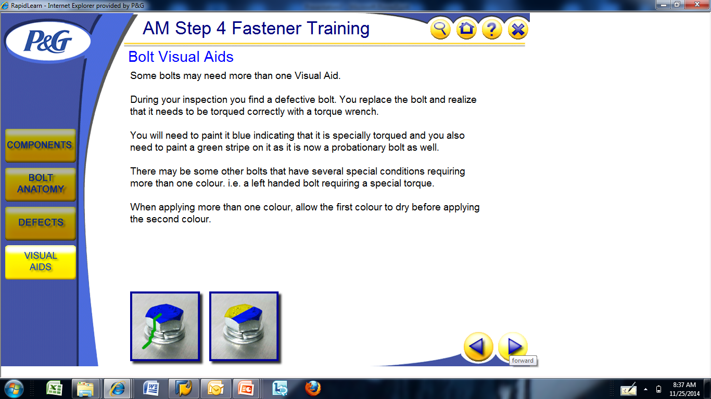
FASTENERS : VISUAL AIDS
Bolt Visual aids :

